Slide 1

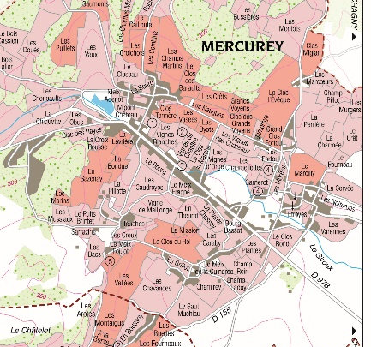
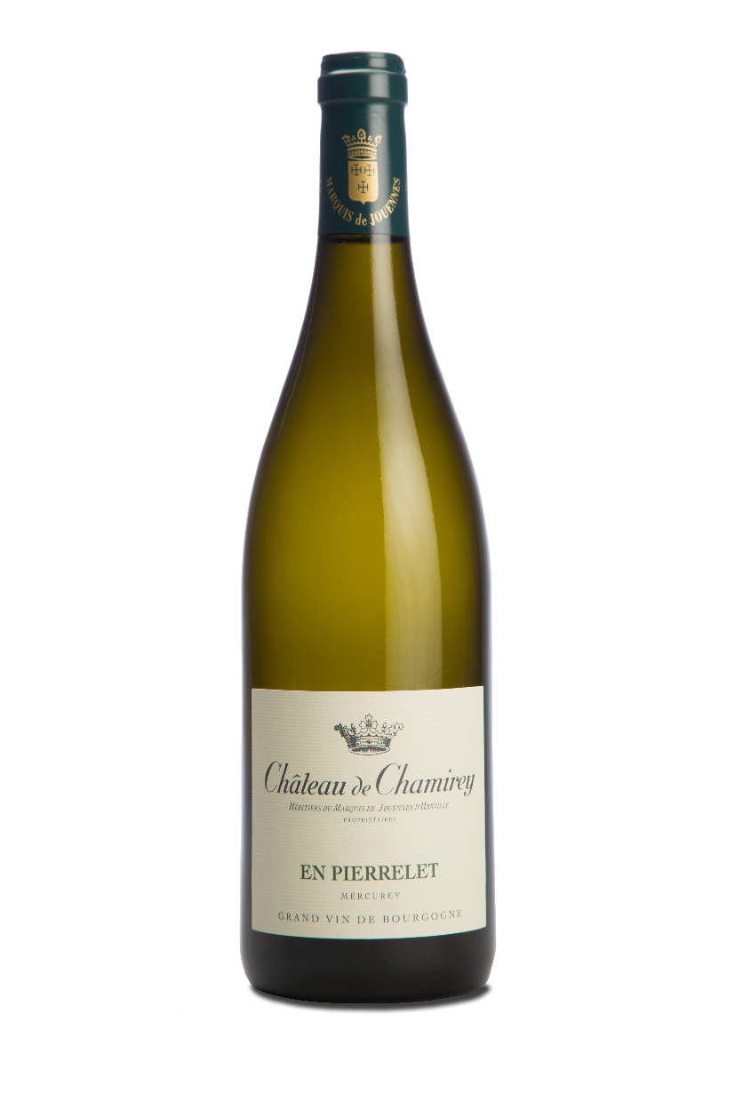
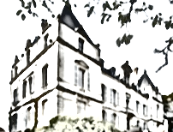
MERCUREY BLANC
EN PIERRELET
2014
TERROIR
Plots : 2 plots ‘En Pierrelet’, planted in 1990, located right behind Château de Chamirey
Surface : 2,9670 hectares (7,32 acres)
Climat & Soil : smooth terrasse offering a mix of clay and limestone with a limestone predominance. Huge concentration of small white stones on the surface. South-East facing.
WINEMAKING
To preserve their integrity, grapes are carefully harvested and sorted out by hand. Full clusters.
Following the pneumatic press, juices stay in a vat overnight for a cool settling down and then are directly filled in barrels by gravity.
Alcoholic and malolactic fermentations take place in barrels.
TASTING NOTES
EYE
Light bright colour with green tints.
NOSE
Salty aromas, iodine and smooth spices : cinnamon, nutmeg. We also get some white peach and apricot notes. Great volume and richness.
PALATE
Freshness and saltiness are predominant. Lovely tension reflecting perfectly the mineral character.
AGING
Aging process is taking place 100% in traditional Burgundian 228 litres barrels as well as 400 litres barrels during 11 months with around 20% of new barrels. We only use light toasted French oak coming mainly from Bourgogne, Allier and Vosges forests.
Light filtration before bottling
SERVICE & CELLARING
It can be served from now at 12-14°C or kept in cellar for 3 to 5 years.
FOOD & WINE PAIRING
A mushroom risotto, poultries with a cream and peperry sauce, chicken with yellow wine will be some tasty receipes for our Mercurey En Pierrelet 2014.
Château de Chamirey
Rue du Château
71640 Mercurey
Tél : 03 85 45 86 55

Slide 2
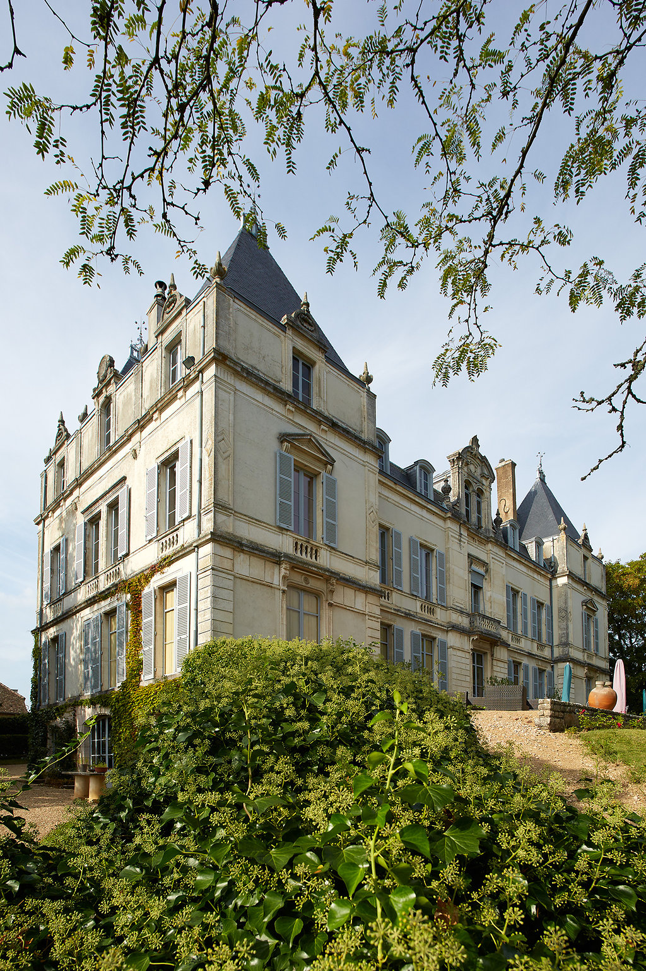
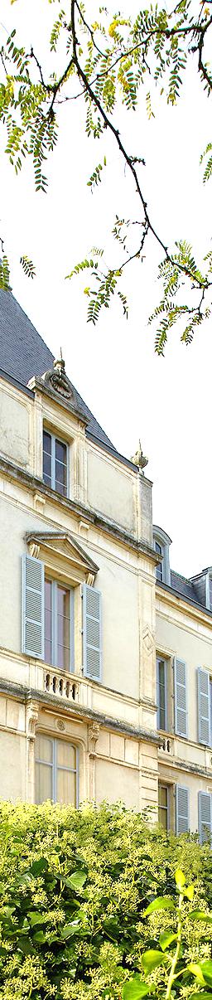

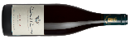

MERCUREY BLANC
EN PIERRELET
2014
15/20
Guide 2017
88/100
« This displays enough reduction and sulfur hints to necessitate a thorough aeration first. Otherwise there is good energy to the succulent and markedly round flavors that are less precise but more mineral-driven on the lemony finale. »
Issue 64, October 8th, 2016
93/100
Top 25 producers in Côte Chalonnaise
Burgundy 2014 Special report, January 2016
90/100
« This is bright and ripe wine. It comes from a single vineyard just behind the chateau of Chamirey. It is warm, rich and generous with a mineral texture and shining acidity. The wine is full of yellow fruits that are contrasted with lemon and a final lively aftertaste. Drink from 2017. »
12/31/2016

