Slide 1
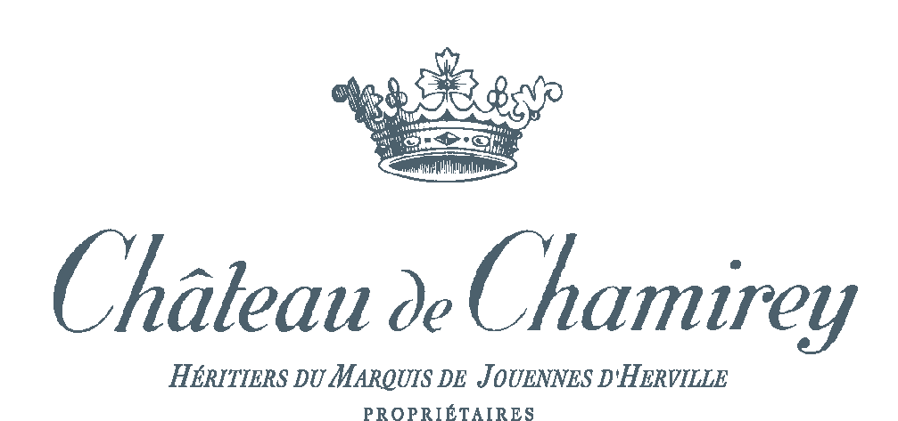
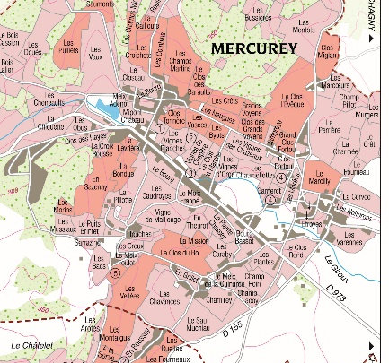
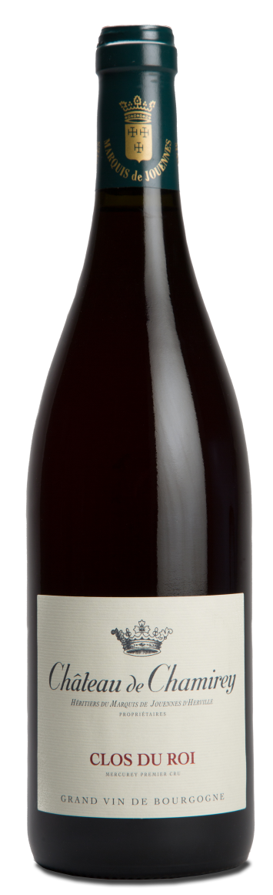
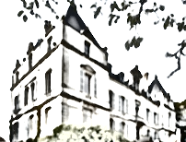
MERCUREY ROUGE PREMIER CRU
CLOS DU ROI
2011
TERROIR
Our vineyard of Clos du Roi is divided into 4 adjacent plots planted between 1970 and 2002.
Total area: 3,089 hectares (7,629 acres)
Climat & Soil : South/South West facing concave slope. Dark brown soil with chalky borders.
WINEMAKING
To preserve their integrity, grapes are carefully harvested and sorted out by hand.
Before beginning the alcoholic fermentation we make a cold pre-fermentation during 4 to 6 days to work on the phelonic component’s exctraction. Grapes are previously partially destemmed. Then full maceration lasts for 15 days during which we’ll use only pigeages (punching the cap). Intensity and numbers are lead to the concentration of tannins, perfumes and colour.
Alcoholic fermentation is realized with natural yeasts.
TASTING NOTES
EYE
Beautiful and deep ruby colour.
NOSE
The nose develops some little fresh red fruits (morello cherry). It is aerial and fine.
PALATE
The palate is again fruity and nicely structured.
Tannins are firm and will integrate the power of the structure in couple of month.
SERVICE & CELLARING
It can be served from now at 13-14°C or kept in cellar between 5 and 7 years.
AGING
After maceration, free and press wines are separated for aging.
Aging process is taking place 100% in traditional Burgundian 228 liters barrels during 15 months with around 40% of new barrels.
We only use French oak coming mainly from Bourgogne, Allier and Vosges forests.
FOOD & WINE PAIRINGS
The Mercurey rouge Premier Cru « Clos du Roi » 2011 will marvelously match with red meats (prime cut of beef, beef coast), navarin lamb, leg of lamb,as well as fat and dry cheese.
Château de Chamirey
Rue du Château
71640 Mercurey
Tél : +33 3 85 45 21 61
contact@domaines-devillard.com

Slide 2
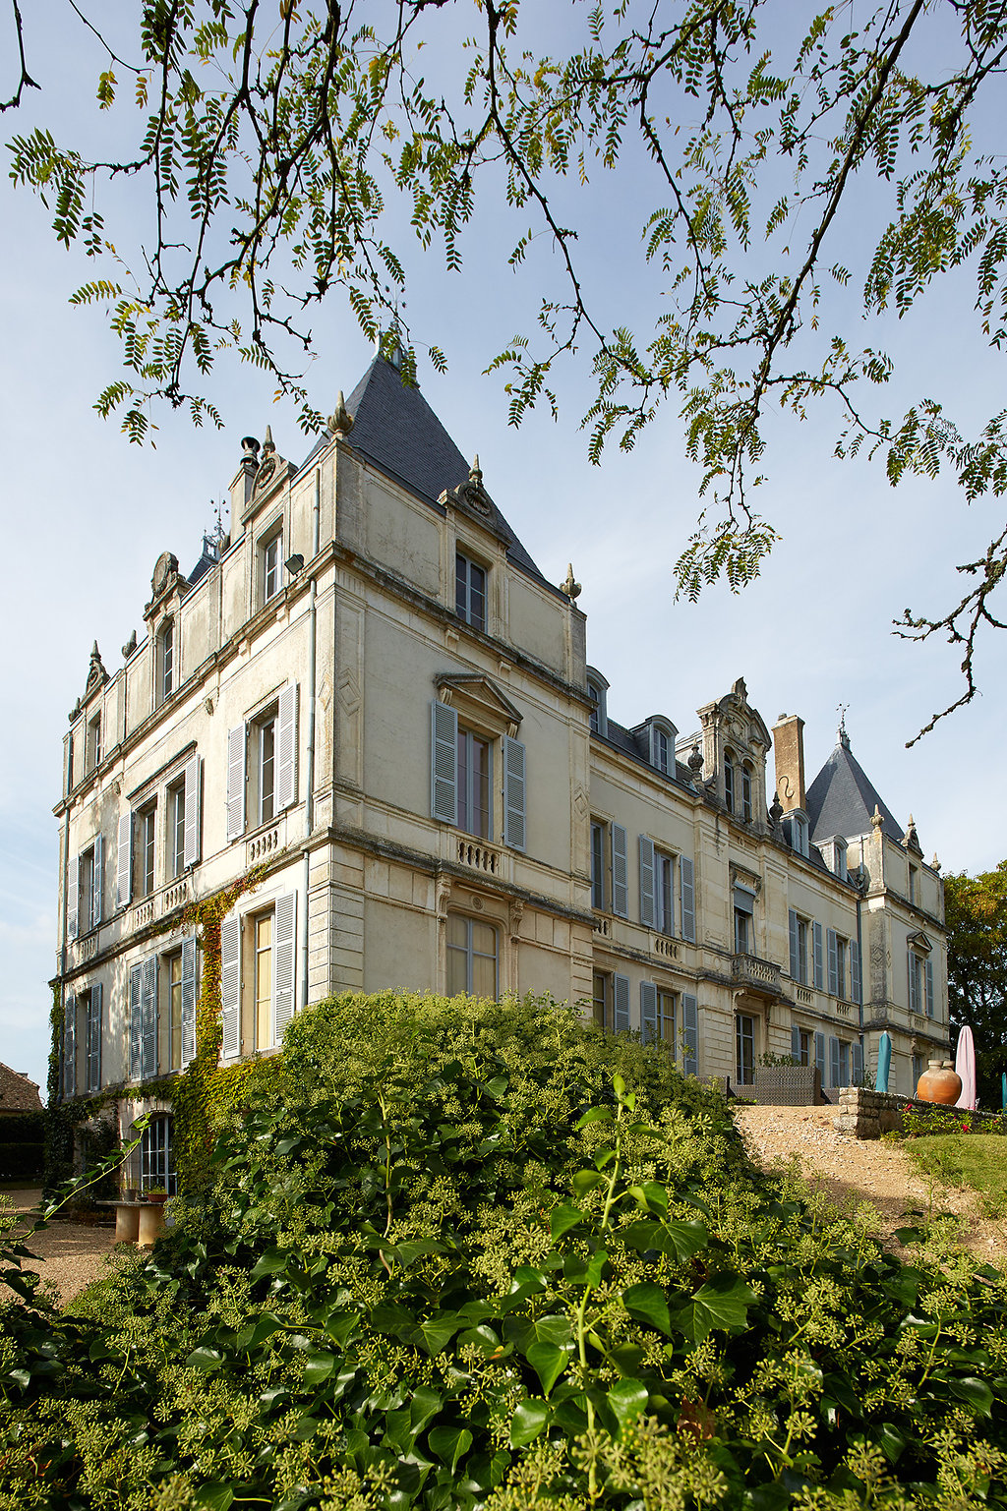
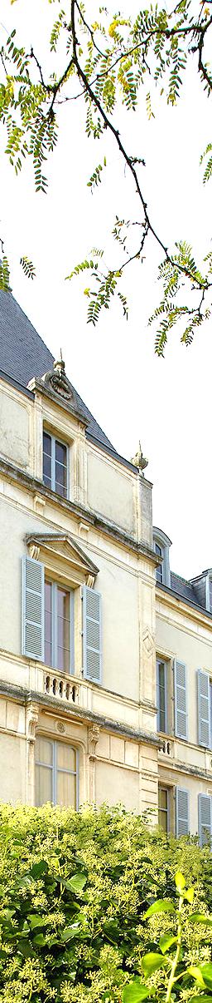
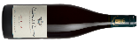



MERCUREY ROUGE PREMIER CRU
CLOS DU ROI
2011
16,5/20
« Matière très riche, un vin de repas, il faut l’attendre encore. »
Guide 2014
14,5/20
Guide 2017
“Grandes Réussites”
89/100
«There is plenty of wood present here as well though it is better integrated as it allows the fresh and cool but ripe aromas of briar, dark berries and earth aromas to be appreciated. The middle weight flavors possess a lovely sense of underlying tension on the detailed and midly rustic finish. This is really quite good and while there is a bit more wood than I prefer it’s not enough to affect the balance. »
Issue 52, October 2013
90/100
« Very structured wine, firmly anchored to a tannic core. The wine has weight, blackberry fruit and dark cherry flavors. It is rich, full-bodied, with great swathes of juicy fruit and acidity. »
Issue web 11/01/2013

